Slide 1
Lecture 2

Slide 2
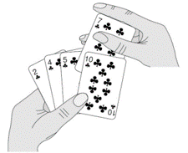
Insertion Sort
Imagine a few playing cards in your hand.
How do you arrange the cards in sorted order??????

Slide 3
How do you sort the cards in your hand???
You extract a card
Shift the remaining cards
Insert the extracted card in the correct place.
Repeat the process till all the cards are sorted.

Slide 4
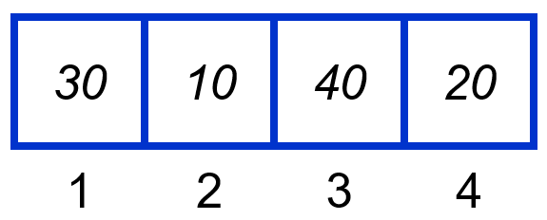
Insertion Sort: The Algorithm
InsertionSort(A, n) { for i = 2 to n { key = A[i] j = i - 1; while (j > 0) and (A[j] > key) { A[j+1] = A[j] j = j - 1 } A[j+1] = key }
}
i = ∅, j = ∅, key = ∅ A[j] = ∅ , A[j+1] = ∅

Slide 5
InsertionSort(A, n) { for i = 2 to n { key = A[i] j = i - 1; while (j > 0) and (A[j] > key) { A[j+1] = A[j] j = j - 1 } A[j+1] = key }
}
i = 2, j = 1, key = 10 A[j] = 30 , A[j+1] = 10

Slide 6
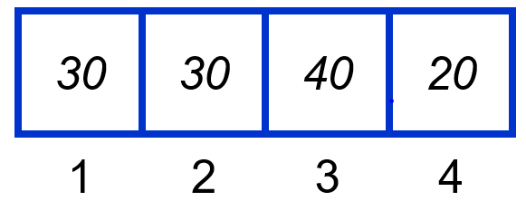
InsertionSort(A, n) { for i = 2 to n { key = A[i] j = i - 1; while (j > 0) and (A[j] > key) { A[j+1] = A[j] j = j - 1 } A[j+1] = key }
}
i = 2, j = 1, key = 10 A[j] = 30, A[j+1] = 30

Slide 7
InsertionSort(A, n) { for i = 2 to n { key = A[i] j = i - 1; while (j > 0) and (A[j] > key) { A[j+1] = A[j] j = j - 1 } A[j+1] = key }
}
i = 2, j = 1, key = 10 A[j] = 30, A[j+1] = 30

Slide 8
InsertionSort(A, n) { for i = 2 to n { key = A[i] j = i - 1; while (j > 0) and (A[j] > key) { A[j+1] = A[j] j = j - 1 } A[j+1] = key }
}
i = 2, j = 0, key = 10 A[j] = ∅, A[j+1] = 30

Slide 9
InsertionSort(A, n) { for i = 2 to n { key = A[i] j = i - 1; while (j > 0) and (A[j] > key) { A[j+1] = A[j] j = j - 1 } A[j+1] = key }
}
i = 2, j = 0, key = 10 A[j] = ∅, A[j+1] = 30

Slide 10
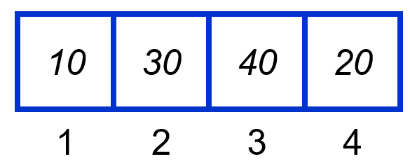
InsertionSort(A, n) { for i = 2 to n { key = A[i] j = i - 1; while (j > 0) and (A[j] > key) { A[j+1] = A[j] j = j - 1 } A[j+1] = key }
}
i = 2, j = 0, key = 10 A[j] = ∅, A[j+1] = 10

Slide 11
InsertionSort(A, n) { for i = 2 to n { key = A[i] j = i - 1; while (j > 0) and (A[j] > key) { A[j+1] = A[j] j = j - 1 } A[j+1] = key }
}
i = 3, j = 0, key = 10 A[j] = ∅, A[j+1] = 10

Slide 12
InsertionSort(A, n) { for i = 2 to n { key = A[i] j = i - 1; while (j > 0) and (A[j] > key) { A[j+1] = A[j] j = j - 1 } A[j+1] = key }
}
i = 3, j = 0, key = 40 A[j] = ∅, A[j+1] = 10

Slide 13
InsertionSort(A, n) { for i = 2 to n { key = A[i] j = i - 1; while (j > 0) and (A[j] > key) { A[j+1] = A[j] j = j - 1 } A[j+1] = key }
}
i = 3, j = 0, key = 40 A[j] = ∅, A[j+1] = 10

Slide 14
InsertionSort(A, n) { for i = 2 to n { key = A[i] j = i - 1; while (j > 0) and (A[j] > key) { A[j+1] = A[j] j = j - 1 } A[j+1] = key }
}
i = 3, j = 2, key = 40 A[j] = 30, A[j+1] = 40

Slide 15
InsertionSort(A, n) { for i = 2 to n { key = A[i] j = i - 1; while (j > 0) and (A[j] > key) { A[j+1] = A[j] j = j - 1 } A[j+1] = key }
}
i = 3, j = 2, key = 40 A[j] = 30, A[j+1] = 40

Slide 16
InsertionSort(A, n) { for i = 2 to n { key = A[i] j = i - 1; while (j > 0) and (A[j] > key) { A[j+1] = A[j] j = j - 1 } A[j+1] = key }
}
i = 3, j = 2, key = 40 A[j] = 30, A[j+1] = 40

Slide 17
InsertionSort(A, n) { for i = 2 to n { key = A[i] j = i - 1; while (j > 0) and (A[j] > key) { A[j+1] = A[j] j = j - 1 } A[j+1] = key }
}
i = 4, j = 2, key = 40 A[j] = 30, A[j+1] = 40

Slide 18
InsertionSort(A, n) { for i = 2 to n { key = A[i] j = i - 1; while (j > 0) and (A[j] > key) { A[j+1] = A[j] j = j - 1 } A[j+1] = key }
}
i = 4, j = 2, key = 20 A[j] = 30, A[j+1] = 40

Slide 19
InsertionSort(A, n) { for i = 2 to n { key = A[i] j = i - 1; while (j > 0) and (A[j] > key) { A[j+1] = A[j] j = j - 1 } A[j+1] = key }
}
i = 4, j = 2, key = 20 A[j] = 30, A[j+1] = 40

Slide 20
InsertionSort(A, n) { for i = 2 to n { key = A[i] j = i - 1; while (j > 0) and (A[j] > key) { A[j+1] = A[j] j = j - 1 } A[j+1] = key }
}
i = 4, j = 3, key = 20 A[j] = 40, A[j+1] = 20

Slide 21
InsertionSort(A, n) { for i = 2 to n { key = A[i] j = i - 1; while (j > 0) and (A[j] > key) { A[j+1] = A[j] j = j - 1 } A[j+1] = key }
}
i = 4, j = 3, key = 20 A[j] = 40, A[j+1] = 20

Slide 22
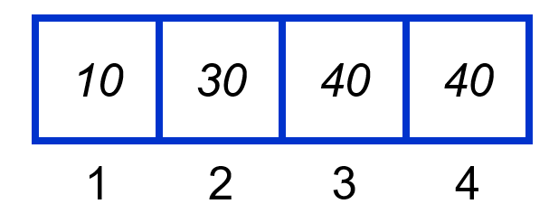
InsertionSort(A, n) { for i = 2 to n { key = A[i] j = i - 1; while (j > 0) and (A[j] > key) { A[j+1] = A[j] j = j - 1 } A[j+1] = key }
}
i = 4, j = 3, key = 20 A[j] = 40, A[j+1] = 40

Slide 23
InsertionSort(A, n) { for i = 2 to n { key = A[i] j = i - 1; while (j > 0) and (A[j] > key) { A[j+1] = A[j] j = j - 1 } A[j+1] = key }
}
i = 4, j = 3, key = 20 A[j] = 40, A[j+1] = 40

Slide 24
InsertionSort(A, n) { for i = 2 to n { key = A[i] j = i - 1; while (j > 0) and (A[j] > key) { A[j+1] = A[j] j = j - 1 } A[j+1] = key }
}
i = 4, j = 2, key = 20 A[j] = 30, A[j+1] = 40

Slide 25
InsertionSort(A, n) { for i = 2 to n { key = A[i] j = i - 1; while (j > 0) and (A[j] > key) { A[j+1] = A[j] j = j - 1 } A[j+1] = key }
}
i = 4, j = 2, key = 20 A[j] = 30, A[j+1] = 40

Slide 26
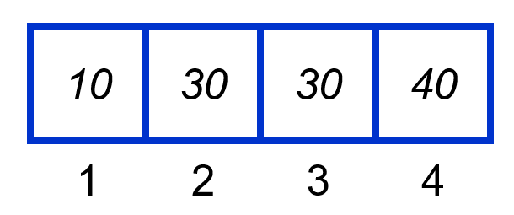
InsertionSort(A, n) { for i = 2 to n { key = A[i] j = i - 1; while (j > 0) and (A[j] > key) { A[j+1] = A[j] j = j - 1 } A[j+1] = key }
}
i = 4, j = 2, key = 20 A[j] = 30, A[j+1] = 30

Slide 27
InsertionSort(A, n) { for i = 2 to n { key = A[i] j = i - 1; while (j > 0) and (A[j] > key) { A[j+1] = A[j] j = j - 1 } A[j+1] = key }
}
i = 4, j = 2, key = 20 A[j] = 30, A[j+1] = 30

Slide 28
InsertionSort(A, n) { for i = 2 to n { key = A[i] j = i - 1; while (j > 0) and (A[j] > key) { A[j+1] = A[j] j = j - 1 } A[j+1] = key }
}
i = 4, j = 1, key = 20 A[j] = 10, A[j+1] = 30

Slide 29
InsertionSort(A, n) { for i = 2 to n { key = A[i] j = i - 1; while (j > 0) and (A[j] > key) { A[j+1] = A[j] j = j - 1 } A[j+1] = key }
}
i = 4, j = 1, key = 20 A[j] = 10, A[j+1] = 30

Slide 30
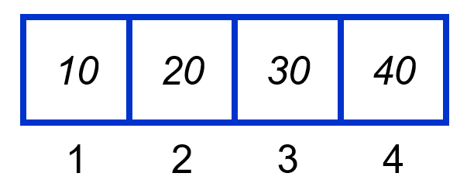

InsertionSort(A, n) { for i = 2 to n { key = A[i] j = i - 1; while (j > 0) and (A[j] > key) { A[j+1] = A[j] j = j - 1 } A[j+1] = key }
}
i = 4, j = 1, key = 20 A[j] = 10, A[j+1] = 20

Slide 31


Slide 32
Analysis of the algorithm
InsertionSort(A, n) { for i = 2 to n { key = A[i] j = i - 1; while (j > 0) and (A[j] > key) { A[j+1] = A[j] j = j - 1 } A[j+1] = key }
}
What is the pre-condition of this for loop?
How many times will the while loop execute?

Slide 33
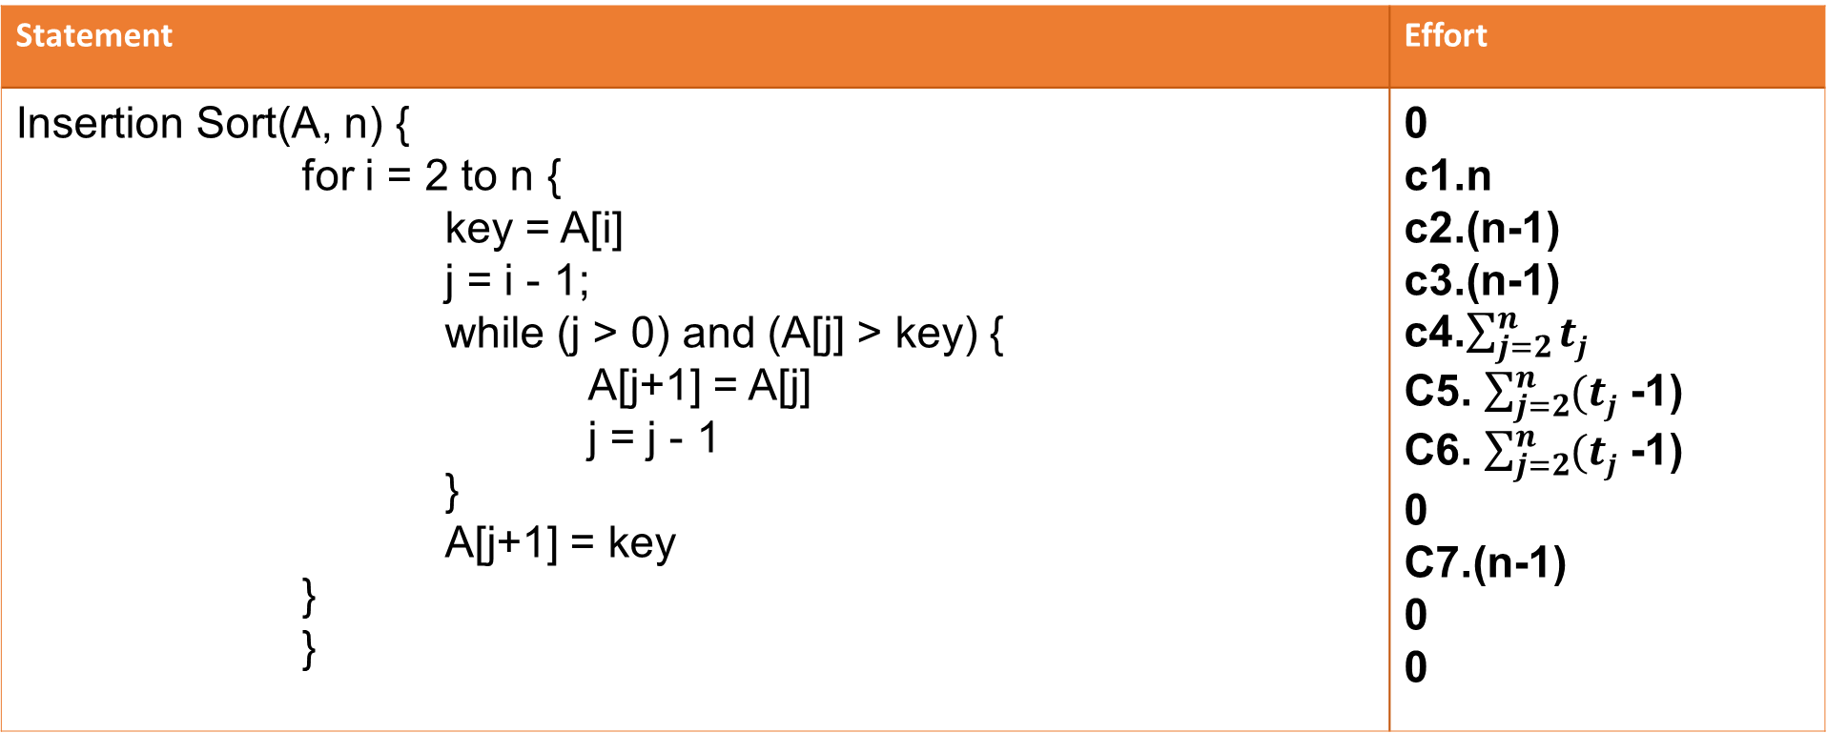
Statement | Effort
Insertion Sort(A, n) { for i = 2 to n { key = A[i] j = i - 1; while (j > 0) and (A[j] > key) { A[j+1] = A[j] j = j - 1 } A[j+1] = key } } | 0 c1.n c2.(n-1) c3.(n-1) c4.$\sum_{j=2}^{n}{tj}$ C5. $\sum_{j=2}^{n}{(tj}$ -1) C6. $\sum_{j=2}^{n}{(tj}$ -1) 0 C7.(n-1) 0 0
T = t₂ + t₃ + … + t_{n} , where t_{j} is number of times while loop is executed for a particular value of j.

Slide 34
Total running time
T(n) = c₁n + c₂(n-1) + c₃(n-1) + c₄T + c₅(T -1)) + c₆(T -1)) + c₇(n-1)
What can T(n) be?
Best case
Input array is already sorted.
T(n) is a linear function
Average case
Each element is halfway in order.
Worst case
array sorted in reverse order.
T(n) is a quadratic function.
Inner loop body is never executed
Inner loop body executed for all previous elements
O(n)
O(n²)
T(n) is a quadratic function.
O(n²)

Slide 35
In Class Practice
Q. Analyse the time complexity for the following code snippets:
1.
int a = 0, b = 0;
for (i = 0; i < N; i++) {
a = a + rand();
}
for (j = 0; j < M; j++) {
b = b + rand();
}
Ans:
a) O(N * M) time, O(1) space
b) O(N + M) time, O(N + M) space
c) O(N + M) time, O(1) space
d) O(N * M) time, O(N + M) space

Slide 36
2.
int a = 0;
for (i = 0; i < N; i++) {
for (j = N; j > i; j--) {
a = a + i + j;
}
}
Ans:
O(N)
O(N*log(N))
O(N * Sqrt(N))
O(N*N)

Slide 37
3.
int i, j, k = 0;
for (i = n / 2; i <= n; i++) {
for (j = 2; j <= n; j = j * 2) {
k = k + n / 2;
}
}
Ans:
O(n)
O(nLogn)
O(n^2)
O(n^2Logn)

Slide 38
4.
int a = 0, i = N;
while (i > 0) {
a += i;
i /= 2;
}
Ans:
O(N)
O(Sqrt(N))
O(N / 2)
O(log N)

Slide 39
5.
int fun1(int n)
{
if (n <= 1) return n;
return 2*fun1(n-1);
}
int fun2(int n)
{
if (n <= 1) return n;
return fun2(n-1) + fun2(n-1);
}

Slide 40
Ans:
O(2^{n}) for both fun1() and fun2()
O(n) for fun1() and O(2^{n}) for fun2()
O(2^{n}) for fun1() and O(n) for fun2()
O(n) for both fun1() and fun2()

Slide 41
Solutions:
Ans 1. c) O(N + M)
Explanation: The first loop is O(N) and the second loop is O(M). Since we don’t know which is bigger, we say this is O(N + M). This can also be written as O(max(N, M)).
Ans 2. d) O(N*N)
Explanation:
The above code runs total no of times
= N + (N – 1) + (N – 2) + … 1 + 0
= N * (N + 1) / 2
= 1/2 * N^2 + 1/2 * N
O(N^2) times.

Slide 42
Ans 3. b) O(nLogn)
Explanation:If you notice, j keeps doubling till it is less than or equal to n. Number of times, we can double a number till it is less than n would be log(n).
Let’s take the examples here.
for n = 16, j = 2, 4, 8, 16
for n = 32, j = 2, 4, 8, 16, 32
So, j would run for O(log n) steps.
i runs for n/2 steps.
So, total steps = O(n/ 2 * log (n)) = O(n*logn)

Slide 43
Ans 4. d) O(log N)
Explanation: We have to find the smallest x such that N / 2^x N
x = log(N)
Ans 5. b) O(n) for fun1() and O(2^{n}) for fun2()

